Slide 1
Chapter 6
SNMPv2
TNM
6-1

Slide 2
Major Changes
Bulk data transfer
Manager-to-manager message
Enhancements to SMI: SMIv2
  Module definitions: MODULE-IDENTITY macro
  Object definitions: OBJECT-TYPE macro
  Trap definitions: NOTIFICATION-TYPE macro
Textual conventions
Conformance statements
Row creation and deletion in table
MIB enhancements
Transport mappings
  Notes
Security features, originally to be in SNMPv2
moved to SNMPv3
SNMPv2, like SNMPv1, is community-based
administrative framework
TNM
6-2

Slide 3
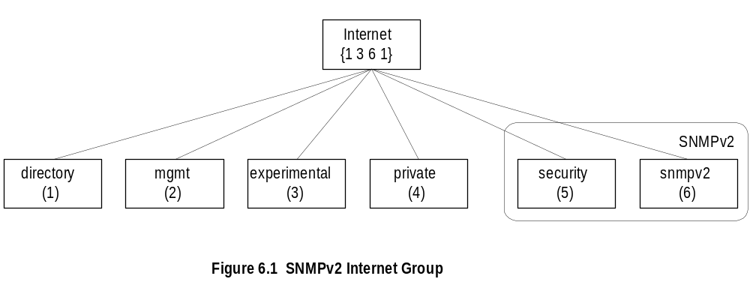
SNMPv2 Internet Group
  Notes
Objects added to System group
Extensive modification of the SNMP group
Additional SNMPv2 group added
Security group is a placeholder
TNM
6-3

Slide 4
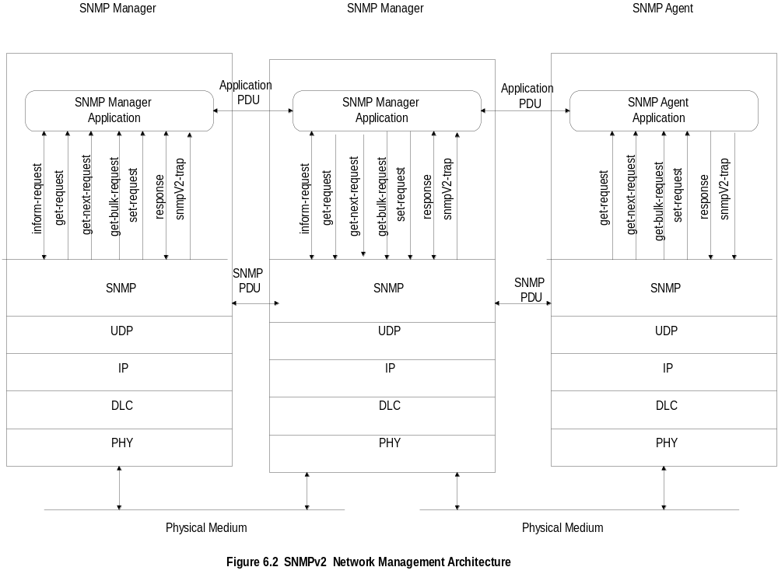
SNMPv2 NM Architecture
TNM
6-4

Slide 5
SNMPv2 New Messages
inform-request
  manager-to-manager message
get-bulk-request
  transfer of large data
report
  not used
  Notes
TNM
Network Management: Principles and Practice
© Mani Subramanian 2000+
6-5

Slide 6
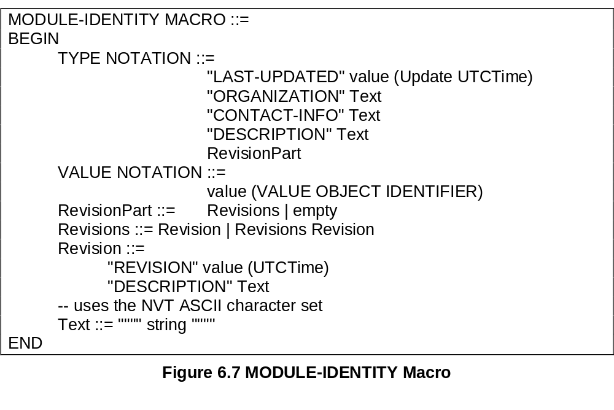
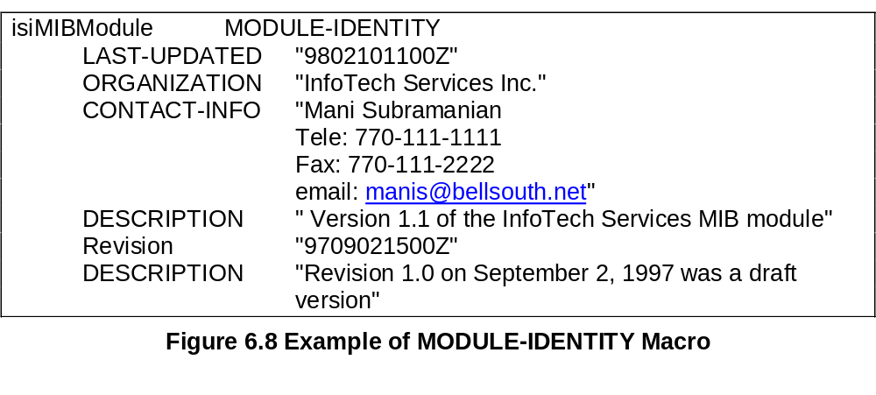
Module Identity Macro
  Notes
Module is a group of related assignments
MODULE-IDENTITY macro defines the
module definitions
TNM
Network Management: Principles and Practice
© Mani Subramanian 2000
6-6

Slide 7
OBJECT ??
OBJECT IDENTIFIER defines the administrative
identification of a node in the MIB
OBJECT-IDENTITY macro assigns an object
identifier to an object identifier in the MIB
OBJECT-TYPE macro defines the type of a
managed object
  Notes
TNM
6-7

Slide 8
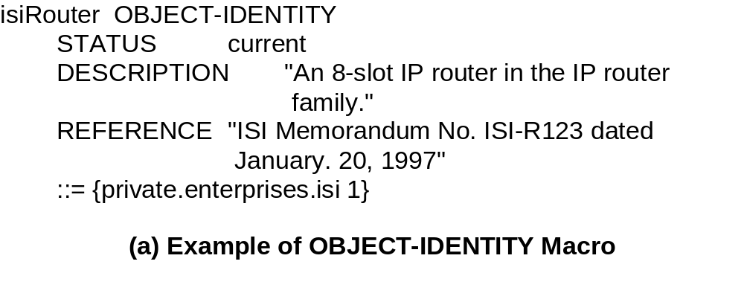
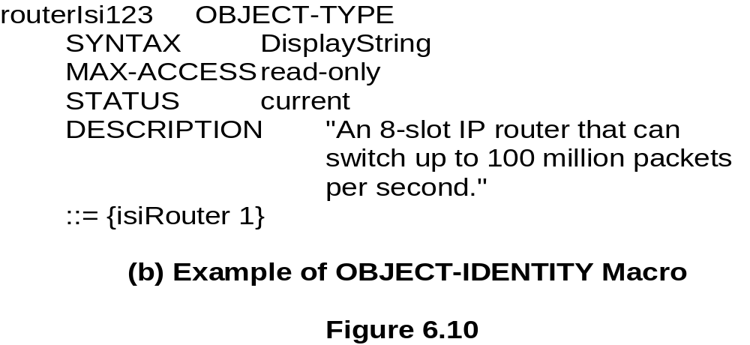
OBJECT-IDENTITY / OBJECT-TYPE
OBJECT-IDENTITY is high level description
OBJECT-TYPE details description needed for
implementation
TNM
6-8

Slide 9
Table Expansion
Augmentation of a table (dependent table)
adds additional columns to an existing table
(base table)
Dense table enables addition of more rows to
base table
Sparse table supplements less rows to a base table
  Notes
TNM
6-9

Slide 10
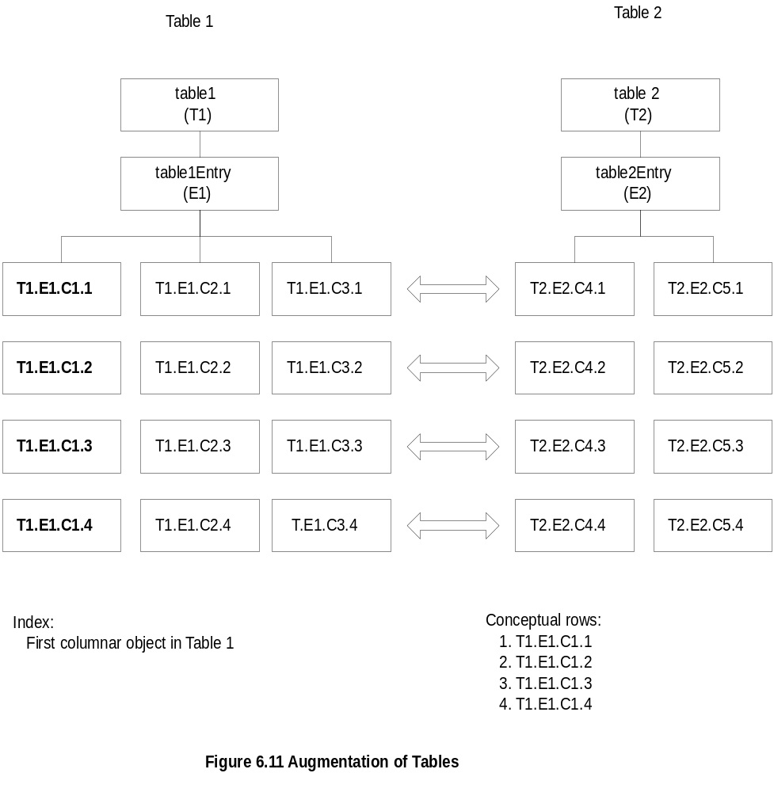
Augmentation of Tables
TNM
6-10

Slide 11
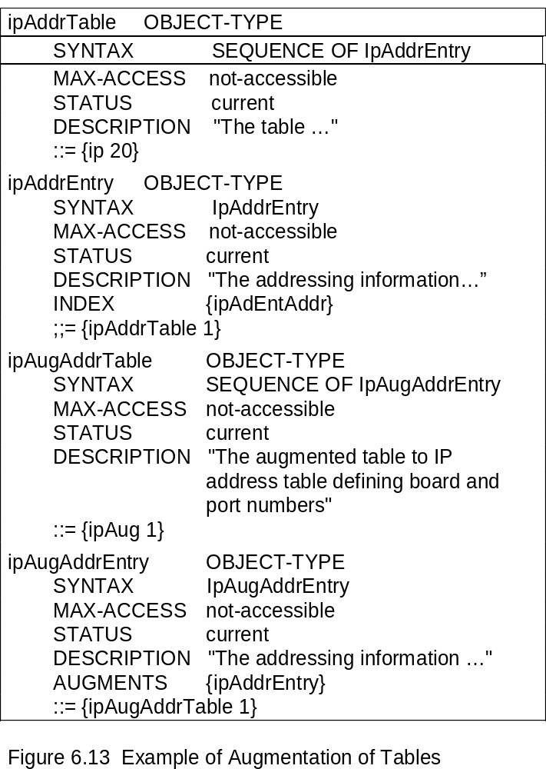
Augmentation of Tables: Example
TNM
6-11

Slide 12
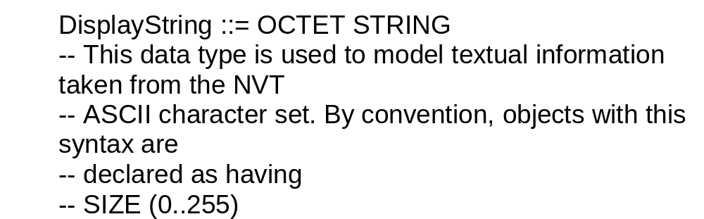
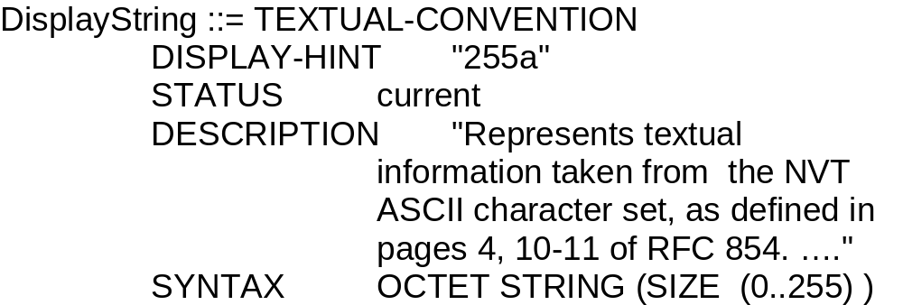
Textual Convention
Enables defining new data types
Makes semantics of data types consistent and
human readable
Creates new data types using existing ones
and applies restrictions to them
An important textual convention in SNMPv2,
RowStatus creates and deletes rows
  Notes
SNMPV1:
SNMPv2:
TNM
6-12

Slide 13
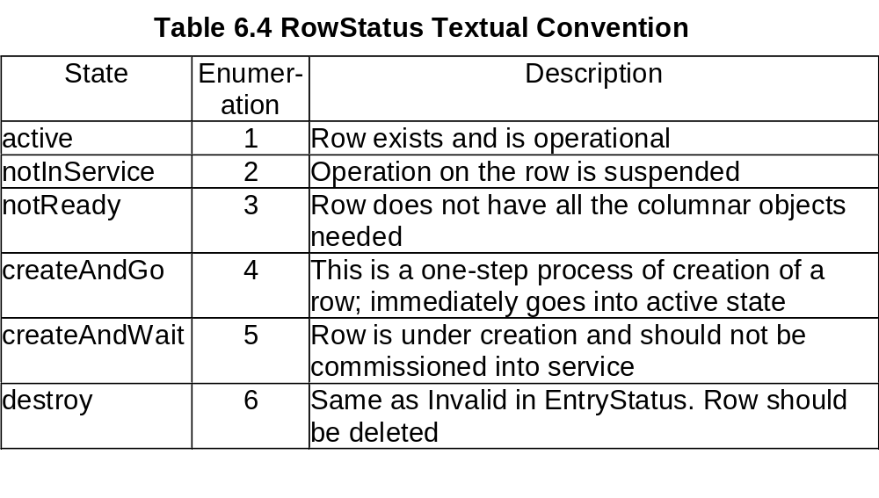
Creation of Row: RowStatus
  Notes
Status: A new column is added
to the conceptual table
SYNTAX of Status is RowStatus
Value of RowStatus is Enumerated INTEGER
TNM
6-13

Slide 14
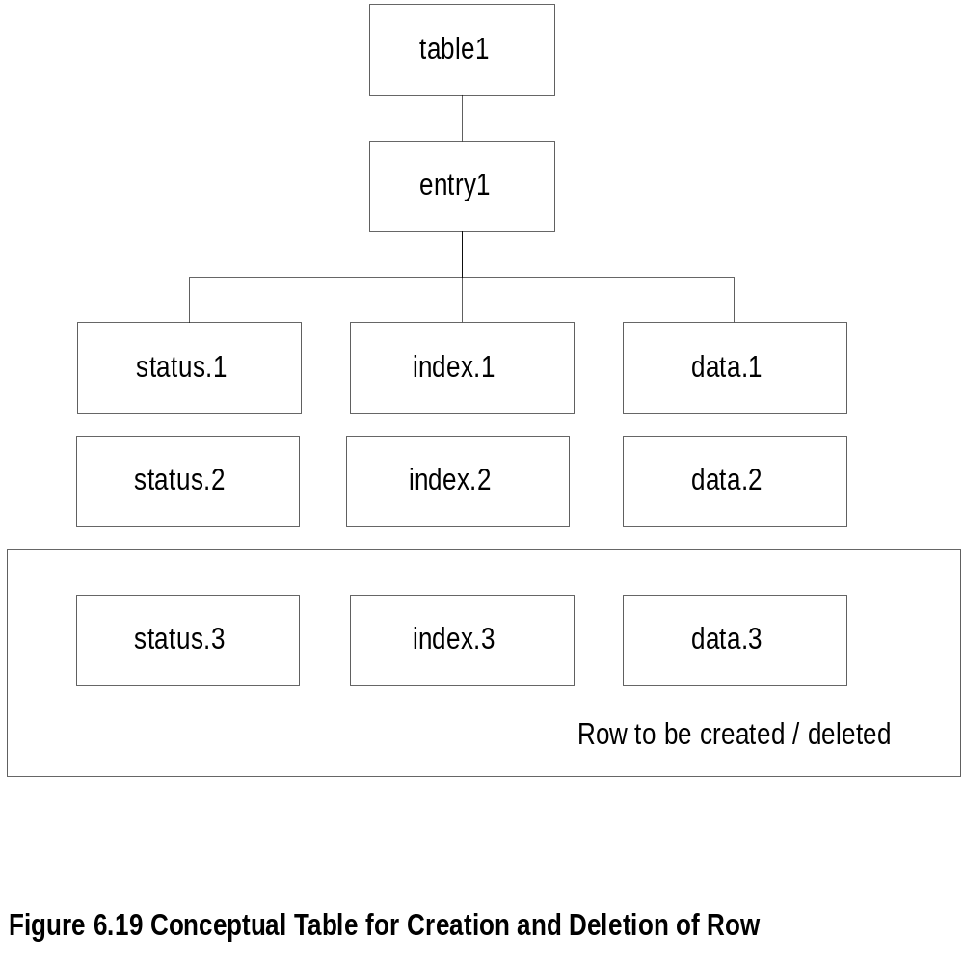
Row Creation and Deletion
  Notes
TNM
6-14

Slide 15
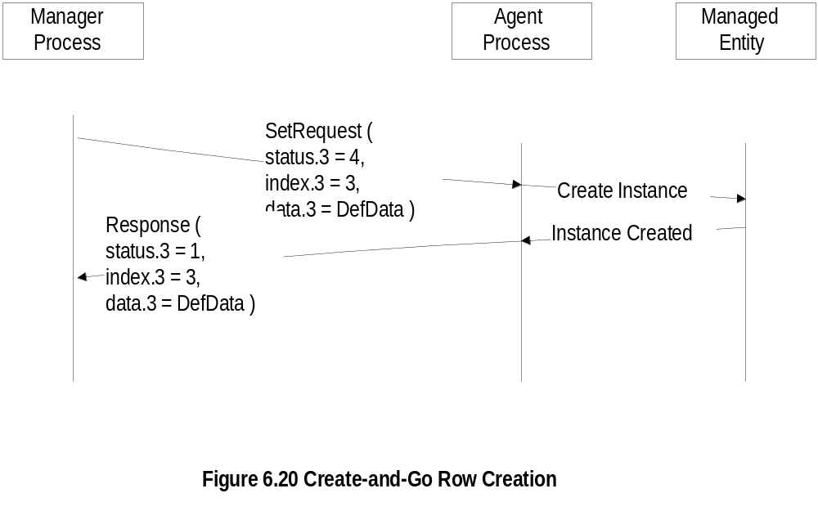
Create-and-Go Row Creation
TNM
6-15

Slide 16
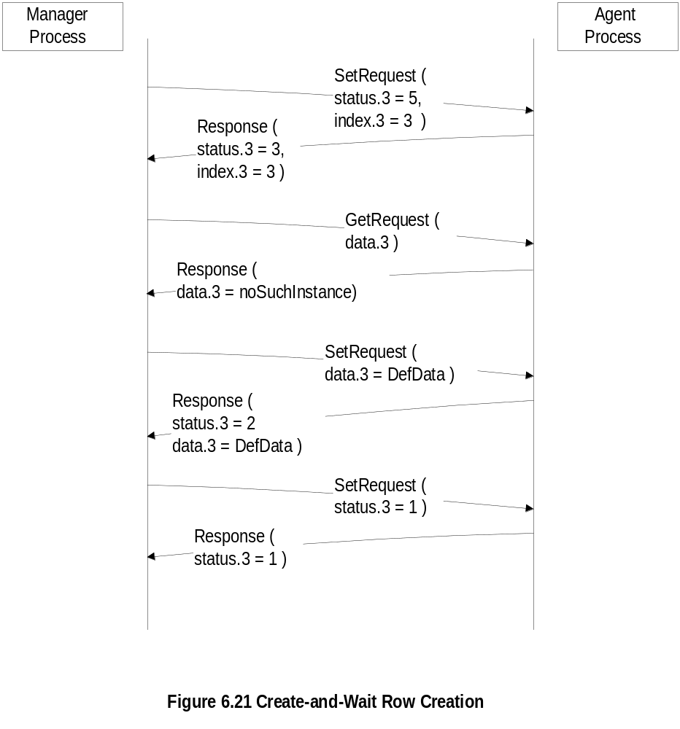
Create-and-Wait:
Row Creation
TNM
6-16

Slide 17
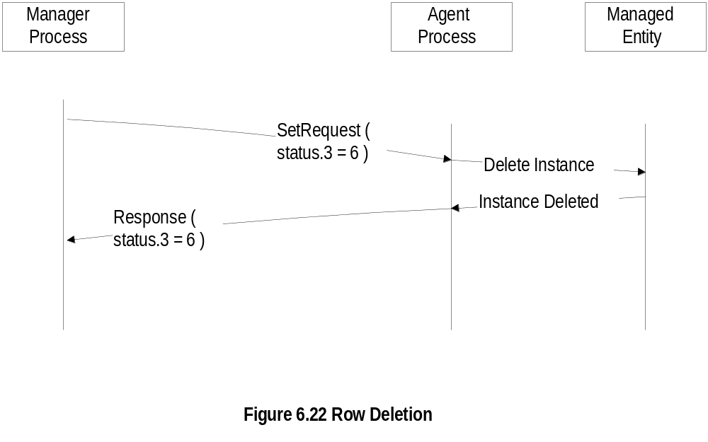
Row Deletion
TNM
6-17

Slide 18
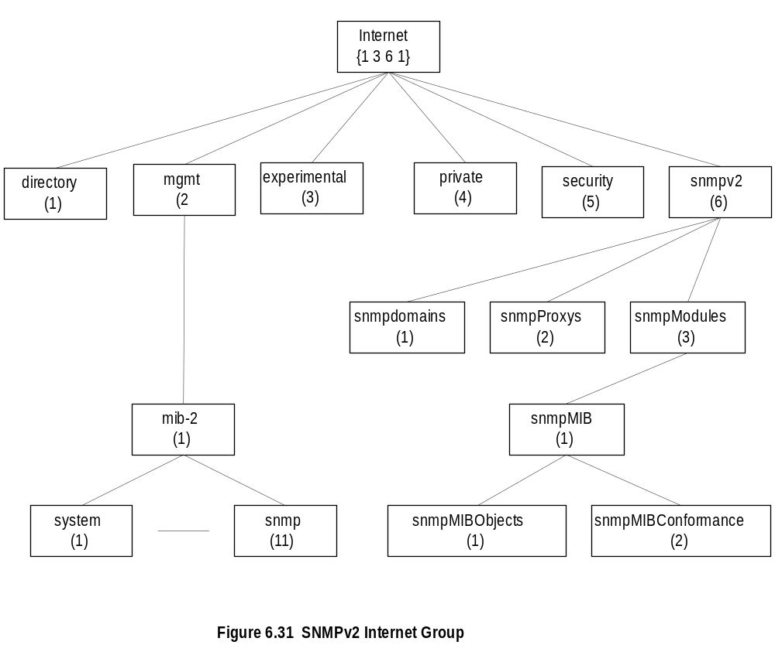
SNMPv2 MIB
  Notes
Security is a placeholder
System group: A table sysORTable added that
lists resources that the agent controls; NMS
configures NE through the agents.
Most of the objects in the SNMPv1 obsoleted
Object Groups and Notification Groups
defined for conformance specifications.
TNM
6-18

Slide 19
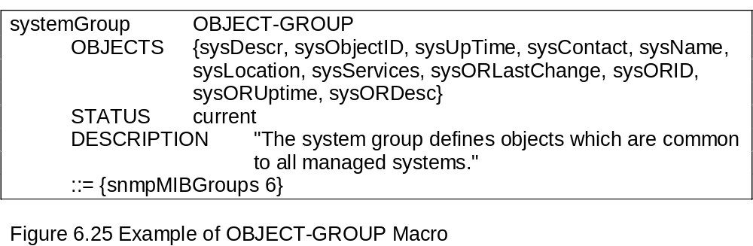
Conformance: OBJECT-GROUP
Conformance defined by
  OBJECT-GROUP macro
  NOTIFICATION-GROUP macro
OBJECT-GROUP
  Compiled during implementation, not at run time
  OBJECTS clause names each object
  Every object belongs to an OBJECT-GROUP
  Access defined by MAX-ACCESS, the maximum
  access privilege for the object
  Notes
TNM
6-19

Slide 20
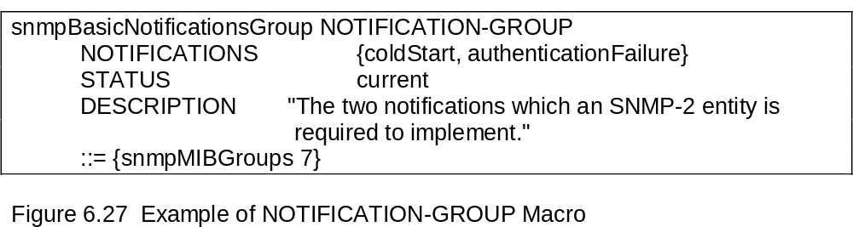
Conformance: NOTIFICATION-GROUP
NOTIFICATION-GROUP
  Contains trap entities defined in SMIv1
  NOTIFICATIONS clause identifies the
  notifications in the group
  NOTIFICATIONS-GROUP macro compiled
  during implementation, not at run time
  Notes
TNM
6-20

Slide 21
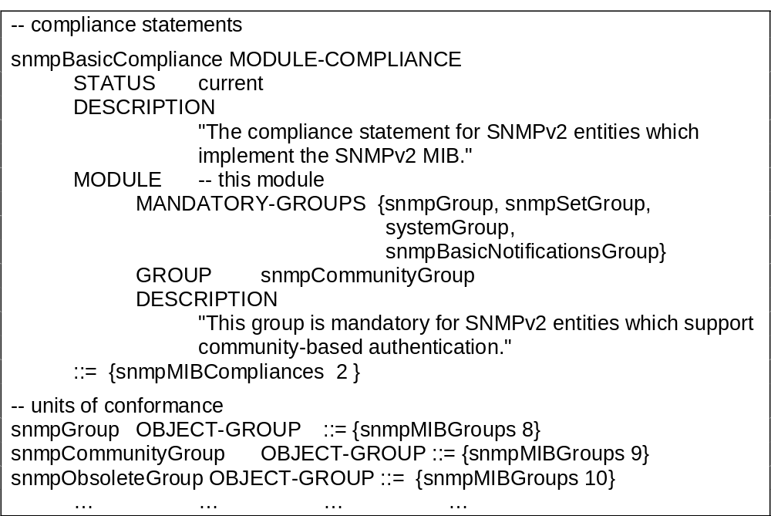
Compliance
Compliance has two classes of groups
  MANDATORY-GROUPS ... Required
  GROUP …Optional
  Notes
TNM
6-21

Slide 22
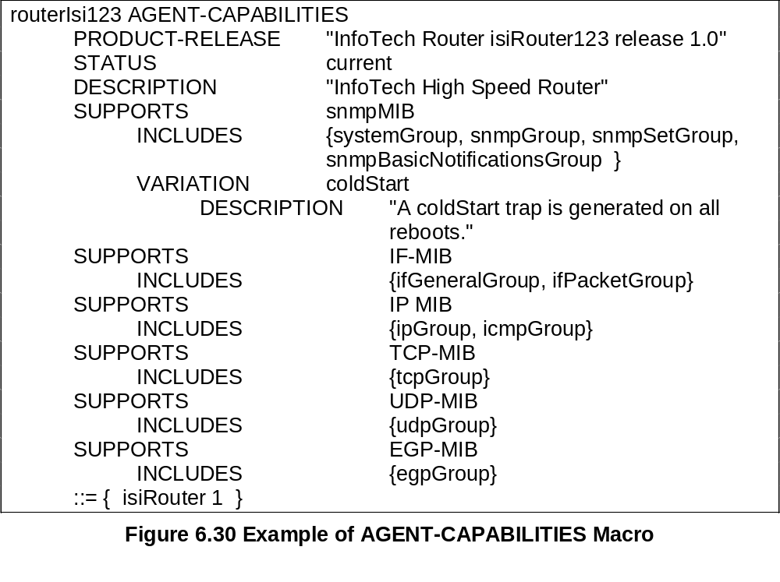
Agent Capabilities
AGENT-CAPABILITIES macro
  SUPPORTS modules and includes groups
  VARIATION identifies additional features
  Notes
TNM
6-22

Slide 23
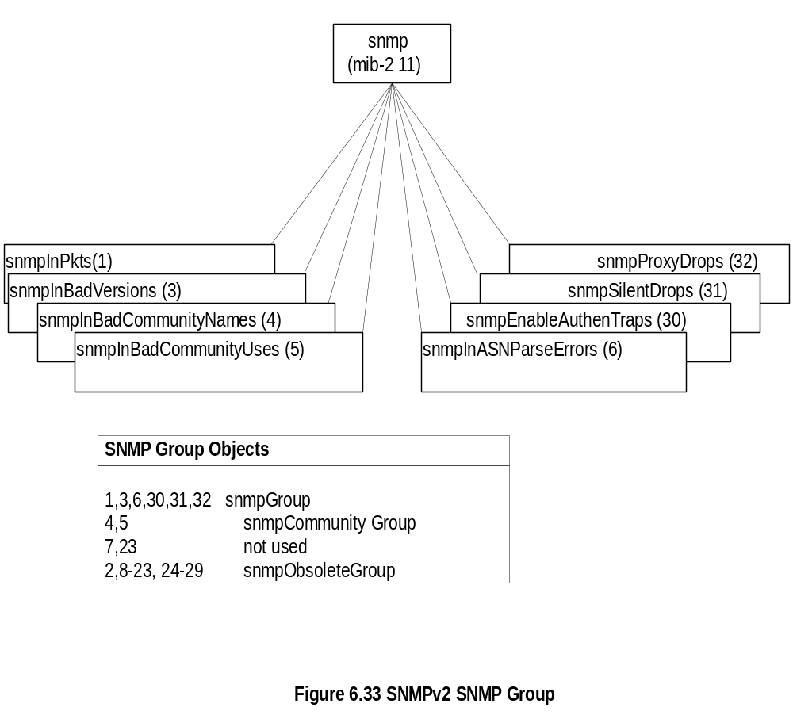
SNMPv2 SNMP MIB
  Notes
TNM
6-23

Slide 24
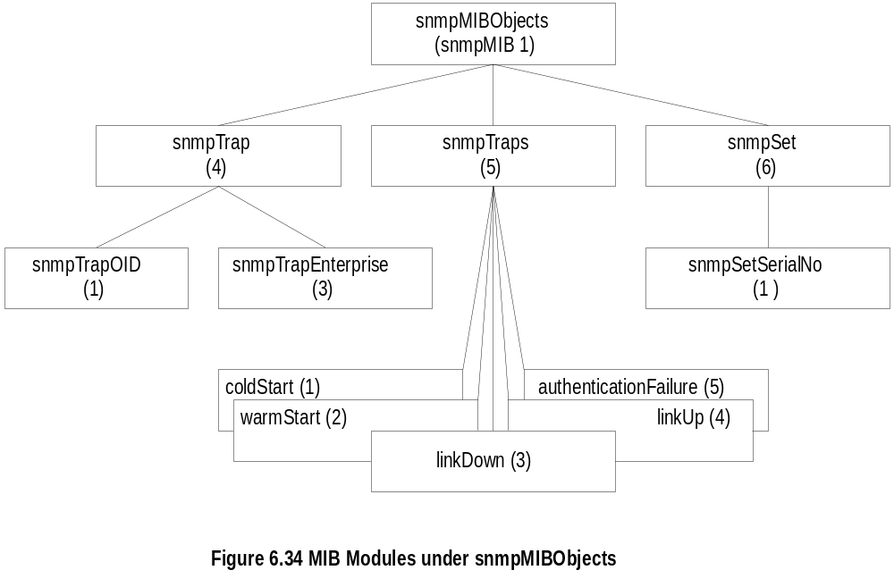
snmpMIBObjects MIB
  Notes
TNM
6-24

Slide 25
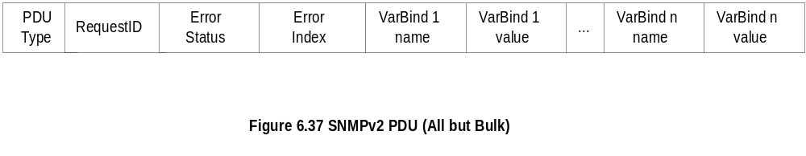
SNMPv2 PDU
  Notes
Standardized format for all messages
Interpretation of error status and error index fields;
In v1, if error occurs status and index field filled, but varBindList blank
Interpretation Status Index
varBindList ignored x
varBind of index field ignored x x
TNM
6-25

Slide 26
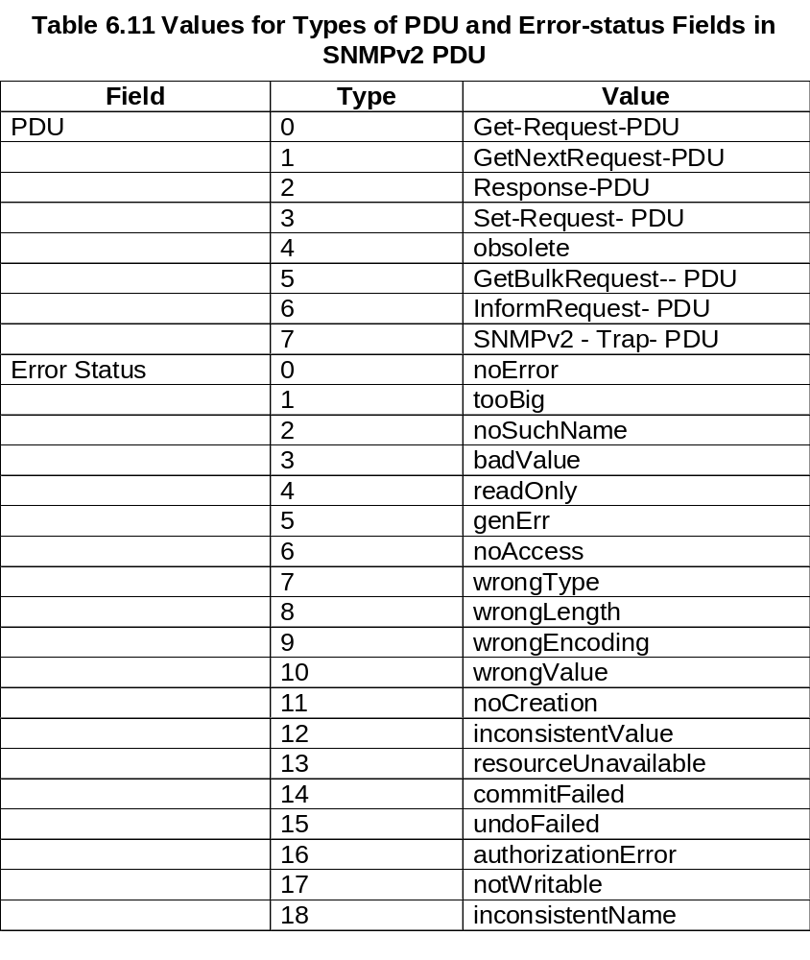
SNMPv2 PDU and Error Status
TNM
6-26

Slide 27
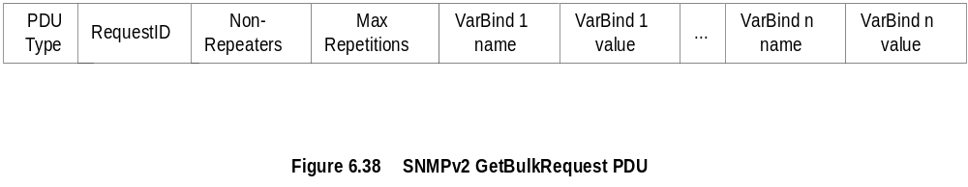
SNMPv2 GetBulkRequest PDU
  Notes
Error status field replaced by Non-repeaters
Error index field replaced by Max repetitions
No one-to-one relationship between request and response
TNM
6-27

Slide 28
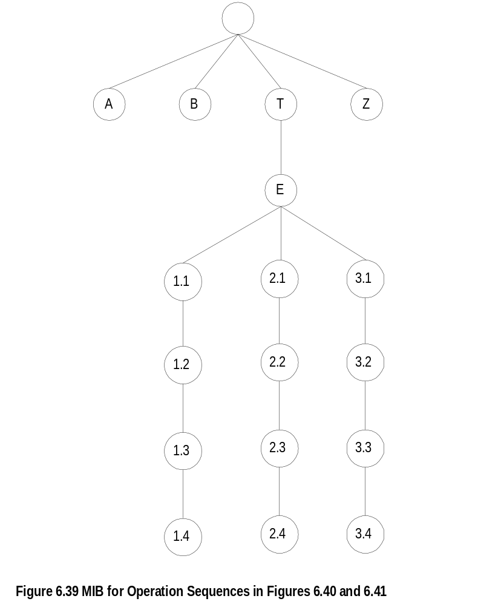
Get-Bulk-Request: Generic MIB
TNM
6-28

Slide 29
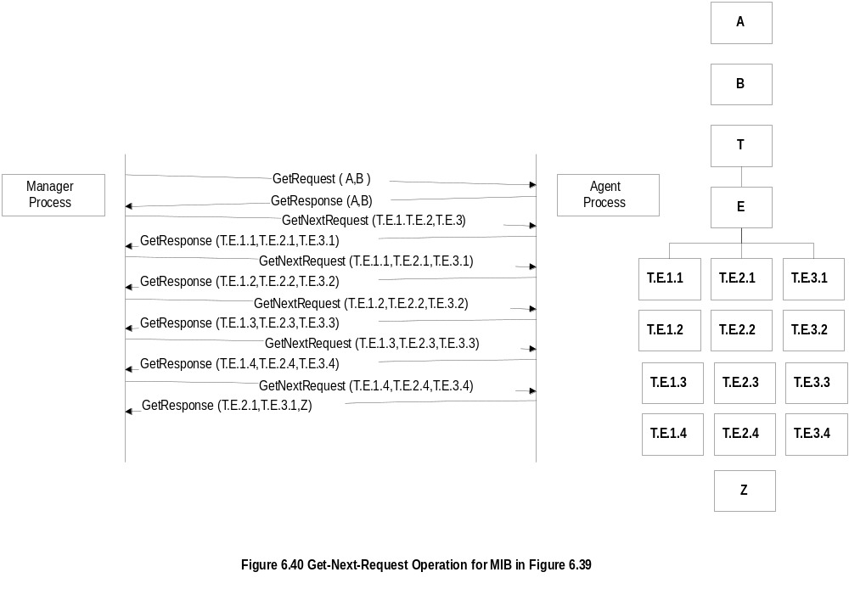
Get-Next-Request Operation
TNM
6-29

Slide 30
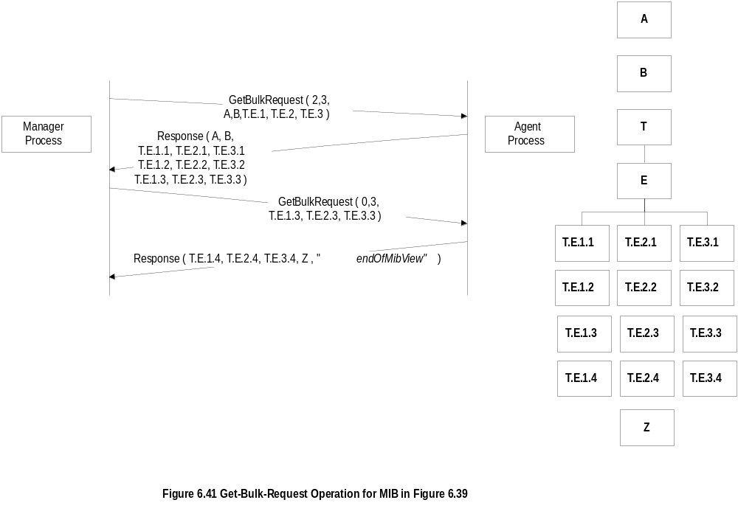
Get-Bulk-Request Operation
TNM
6-30

Slide 31
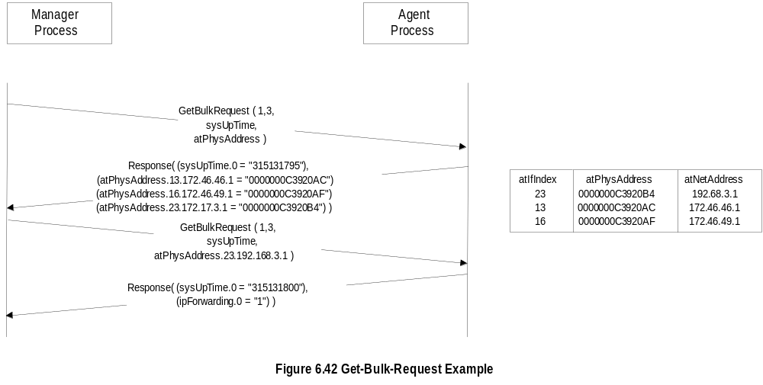
Get-Bulk-Request Example
  Notes
TNM
6-31

Slide 32
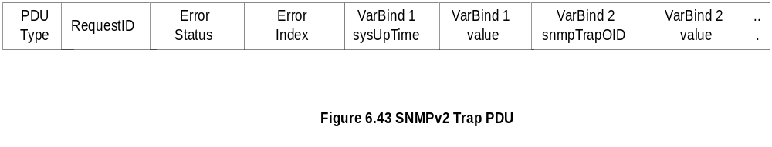
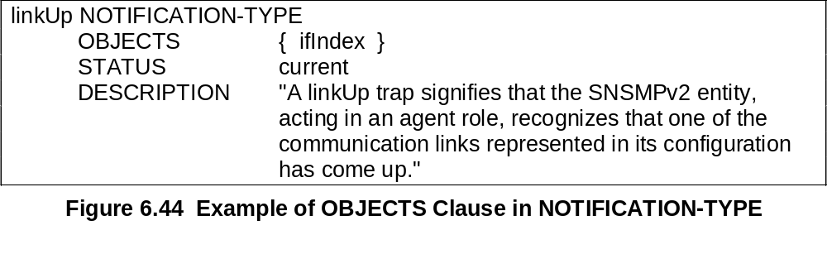
SNMPv2 Trap
  Notes
Addition of NOTIFICATION-TYPE macro
OBJECTS clause, if present, defines order of variable bindings
Positions 1 and 2 in VarBindList are sysUpTime and snmpTrapOID
TNM
6-32

Slide 33
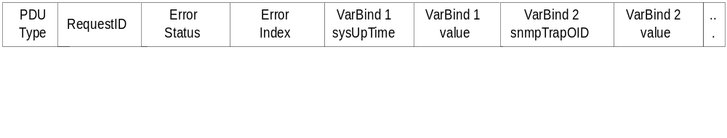
Inform-Request
  Notes
Inform-Request behaves as trap in that the message goes from one
manager to another unsolicited
The receiving manager sends response to the sending manager
TNM
6-33

Slide 34
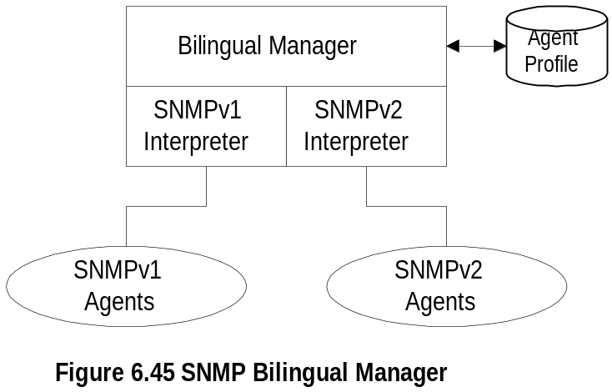
Bilingual Manager
  Notes
Compatibility with SNMPv1
  Bilingual Manager
  Proxy Server
Bilingual Manager expensive in resource
and operation
TNM
6-34

Slide 35
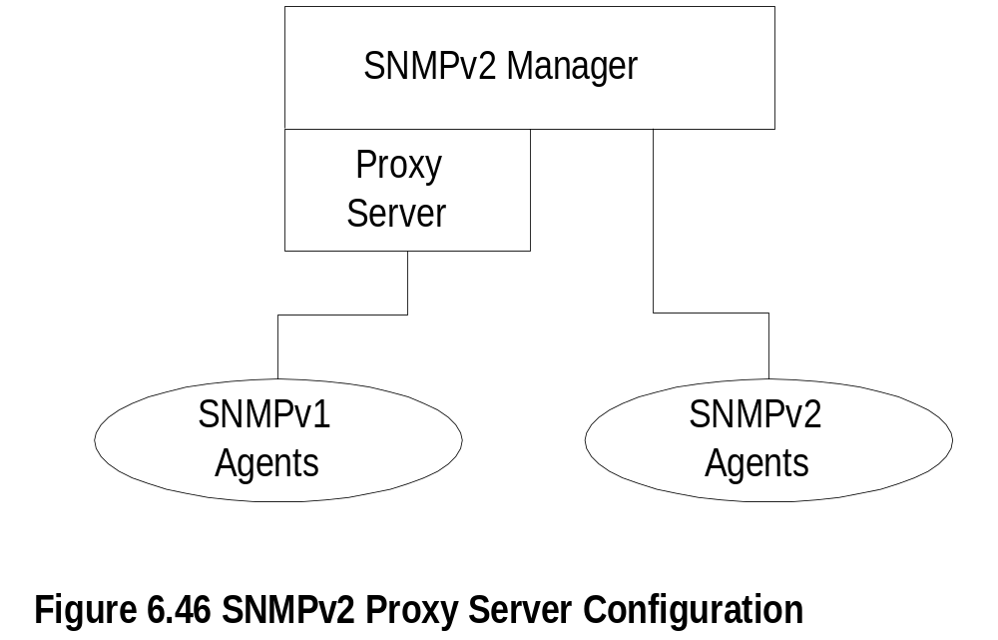
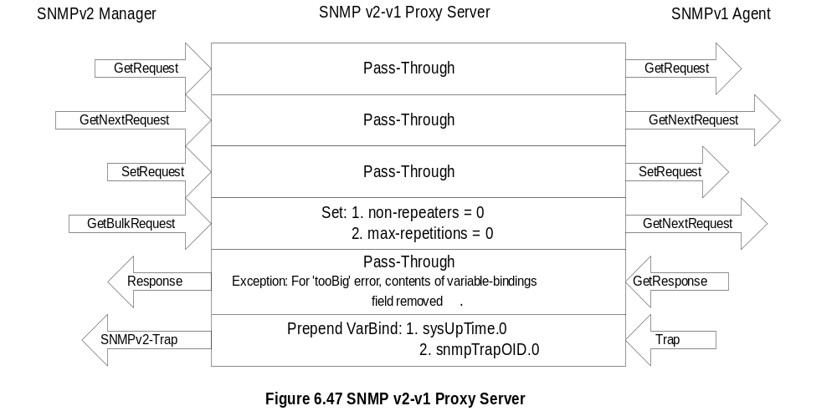
SNMP Proxy Server
TNM
Network Management: Principles and Practice
© Mani Subramanian 2000
6-35

